Slide 1

Document Managment System
Creating a Mini-Archive for University Collaboration
Date: 14 / 01 / 2024

Slide 2
List of members
01
03
02
Nde Dilan
Mapa Caline
Noa Frederic

Slide 3
Table of contents
01
02
03
04
05
06
Introduction
Purpose of the project
Key Requirements
Use Case Diagram
application flow chart
Other Diagrams +3
07
Software Application

Slide 4
01
Introduction
Welcome, everyone. Today, we are thrilled to present our project, which aims to address the evolving needs of the university concerning collaboration and accreditation. In 2024, both students and employees will be required to submit various documents due to these requirements. This collaboration demands an efficient document management system.

Slide 5

What’s the purpose of the Project?
02
The primary objective is to create a mini-archive – a sophisticated document management system capable of handling diverse document types.
This system will streamline the submission, storage, retrieval, and organization of documents, catering to tasks like editing, printing, and reading.
The ultimate goal is to enhance accessibility and efficiency by organizing documents based on criteria such as faculty, department, instructor, and other relevant parameters.

Slide 6
Key Requirements from Stakeholders
03
Document Validation Process :It ensures the accuracy and reliability of submitted documents
Organization of Documents: helps streamline document management based on different criteria.
Send Notifications for Accepted Documents: Informs users of document acceptance.

Slide 7
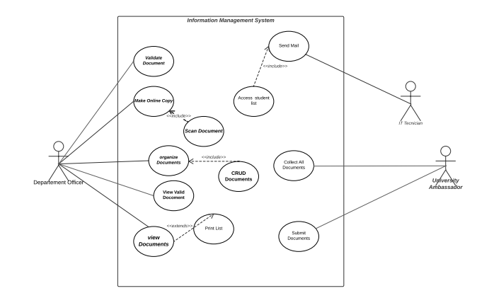
Use Case Diagram

Slide 8
Description of some use cases
The department officer validates submitted documents by checking for errors or non-valid information.
If errors are found, the department officer communicates the issues to the user for correction.
Actors: Departement Officer
Validate Document
The department officer scans the validated physical document and saves the scanned file on the cloud.
The cloud storage wil be decided after a serious study of the available services.
Actors: Departement Officer
Online Version of the Validated Document

Slide 9
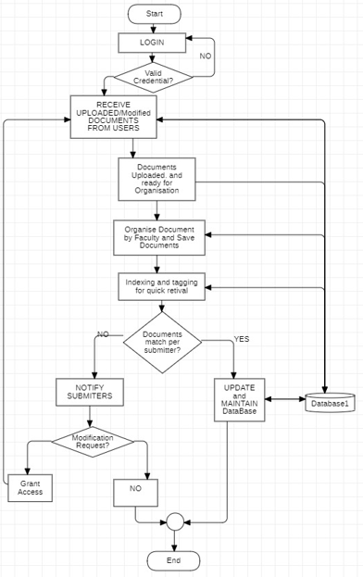
Flow Chart Diagram: Flow of one of the use cases done by the admin(departement officer)

Slide 10
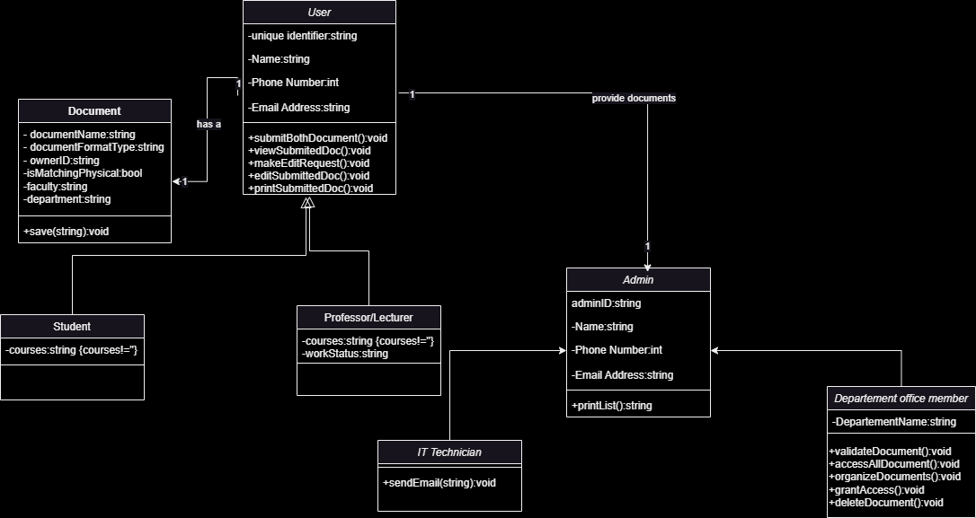
UML Class Diagram

Slide 11
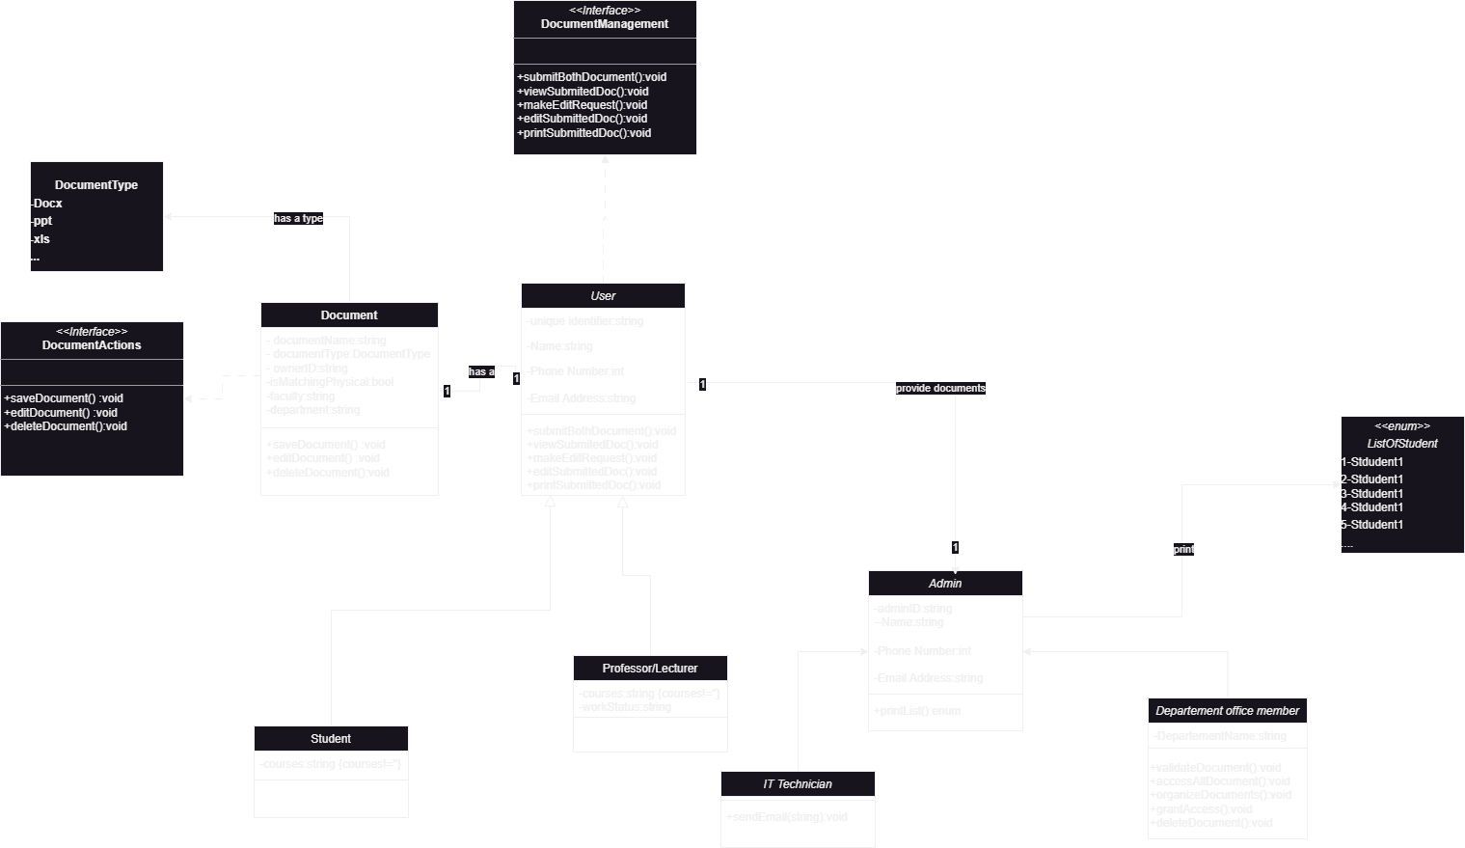
UML Class Diagram With Design Priciples

Slide 12
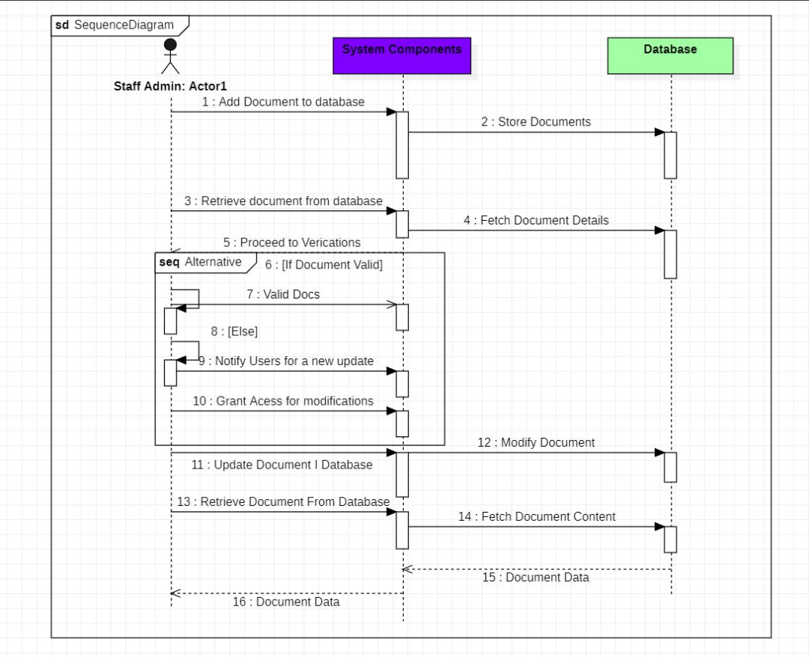
Sequence Diagram

Slide 13
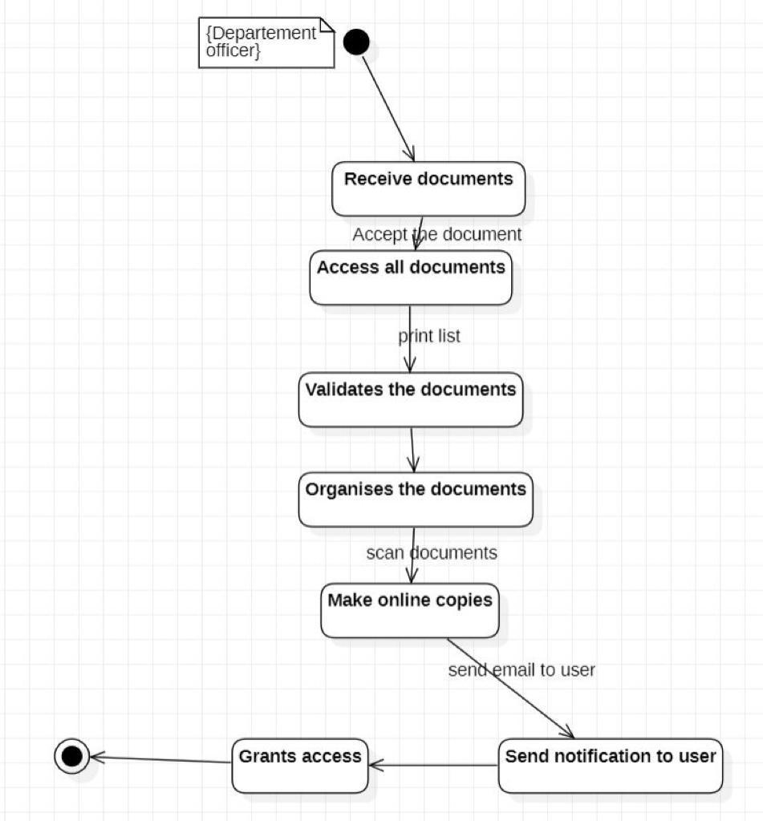
Transition Diagram

Slide 14
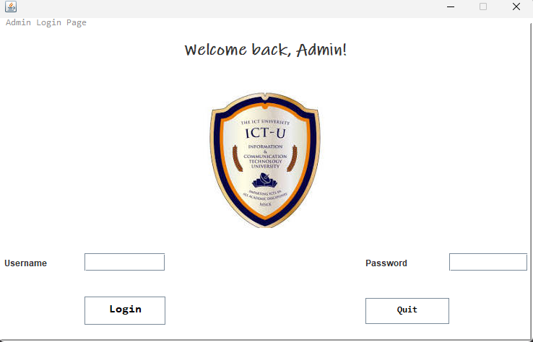
Software Application: Login Page

Slide 15



Thanks!
Do you have any questions?
group16@gmail,com
+237 694 52 59 31
Please keep this slide for attribution

